Slide 1

CS 261 – Recitation 8
Oregon State University
School of Electrical Engineering and Computer Science
Winter 2013

Slide 2
Outline
AVL
Heaps & Priority Queues
File operations.
Hash Table
Examples
Materials in these slides were collected from different Internet sources. Please refer to the class notes for our assumptions in a heap implementation.
CS 261 – Data Structures

Slide 3
Exercises: AVL tree
Insert the following nodes to an empty AVL tree.
38, 30, 40, 25, 35, 39, 34, 37, 33
CS 261 – Data Structures

Slide 4
Exercises: AVL tree
Insert 38, 30, 40, 25, 35, 39, 34, 37, 33 to an empty AVL tree
38(4)
unbalanced
38(4)
38(3)
30(3)
40(1)
30(3)
40(1)
30(2)
40(1)
25(0)
35(2)
39(0)
25(0)
35(2)
39(0)
25(0)
35(1)
39(0)
34(1)
37(0)
34(1)
37(0)
34(0)
37(0)
33(0)
33(0)
CS 261 – Data Structures

Slide 5
Exercises: AVL tree
Insert 38, 30, 40, 25, 35, 39, 34, 37, 33 to an empty AVL tree
38(4)
unbalanced
38(4)
unbalanced
30(3)
40(1)
30(3)
40(1)
25(0)
35(2)
39(0)
25(0)
34(2)
39(0)
34(1)
37(0)
33(0)
35(1)
33(0)
Rot 1
37(0)
unbalanced
38(4)
38(3)
30(3)
Rot 2
40(1)
34(2)
40(1)
25(0)
34(2)
39(0)
30(1)
35(1)
39(0)
33(0)
35(1)
25(0)
33(0)
37(0)
37(0)
CS 261 – Data Structures

Slide 6
Heaps and priority queues
What is a priority queue?
  Collection that helps finding the element with highest priority in constant time.
What is the priority queue interface?
    void add (EleType newValue);
    EleType getFirst ();
    void removeFirst ();
What is a binary heap?
  A complete binary tree in which every node’s value is less than or equal to the values of its children. (The shape property and the heap property)
What is the difference between a min heap and a max heap?
  In a min heap the parent’s priority is < its children’s priority.
  in a max heap the parent’s priority is > its children’s priority.
CS 261 – Data Structures
Notes:
complete binary tree
(data structure)
Definition: A binary tree in which every level, except possibly the deepest, is completely filled. At depth n, the height of the tree, all nodes must be as far left as possible. (Same as our implementation)
Generalization (I am a kind of ...)
complete tree, binary tree.
Specialization (... is a kind of me.)
binary heap.
See also full binary tree, perfect binary tree, extendible hashing, heap.
Note: A complete binary tree has 2^{k} nodes at every depth k < n and between 2^{n} and 2^{n+1}-1 nodes altogether. It can be efficiently implemented as an array, where a node at index i has children at indexes 2i and 2i+1 and a parent at index i/2, with one-based indexing. If child index is greater than the number of nodes, the child does not exist.
After LK.
(From NIST)

Slide 7
Heaps and priority queues
What is an efficient way to implement a binary heap?
  Using an array (dyArray)
Suppose the root has index 0, what are the indices of the 2 children of a node at index i ?
What is the index of the parent of a node at index i ?
2 * i + 1, 2 * i + 2
(i-1)/2
2
3
5
9
10
7
8
0
2
1
3
2
5
3
9
4
10
5
7
6
8
7
14
8
12
9
11
10
16
14
12
11
16
CS 261 – Data Structures

Slide 8
Heaps and priority queues
How to get the smallest element from a binary heap?
  Return the first element.
How to add a new element to a binary heap?
  Insert the new element at the end of the heap
  Fix the heap order
2
3
5
Add 4 to this heap??
9
10
7
8
14
12
11
16
4
CS 261 – Data Structures

Slide 9
Heaps and priority queues
How to get the smallest element from a binary heap?
  Return the first element.
How to add a new element to a binary heap?
  Insert the new element at the end of the heap
  Fix the heap order
2
3
5
Add 4 to this heap??
9
10
4
8
14
12
11
16
7
CS 261 – Data Structures

Slide 10
Heaps and priority queues
How to get the smallest element from a binary heap?
  Return the first element.
How to add a new element to a binary heap?
  Insert the new element at the end of the heap
  Fix the heap order
2
3
4
Add 4 to this heap??
9
10
5
8
14
12
11
16
7
CS 261 – Data Structures

Slide 11
Heaps and priority queues
When removing the first element, which element will replace it?
  The last element !
After removing, we need to call adjust heap to adjust the heap by swapping with the smallest child.
Root = Smallest element
2
3
5
9
10
7
8
14
12
11
16
Last filled position
CS 261 – Data Structures

Slide 12
Heaps and priority queues
When removing the first element, which element will replace it?
  The last element !
After removing, we need to call adjust heap to adjust the heap by swapping with the smallest child.
16
3
5
9
10
7
8
14
12
11
CS 261 – Data Structures

Slide 13
Heaps and priority queues
When removing the first element, which element will replace it?
  The last element !
After removing, we need to call adjust heap to adjust the heap by swapping with the smallest child.
3
16
5
9
10
7
8
14
12
11
CS 261 – Data Structures

Slide 14
Heaps and priority queues
When removing the first element, which element will replace it?
  The last element !
After removing, we need to call adjust heap to adjust the heap by swapping with the smallest child.
3
9
5
16
10
7
8
14
12
11
CS 261 – Data Structures

Slide 15
Heaps and priority queues
When removing the first element, which element will replace it?
  The last element !
After removing, we need to call adjust heap to adjust the heap by swapping with the smallest child.
3
9
5
12
10
7
8
14
16
11
CS 261 – Data Structures

Slide 16
Stability
A stable algorithm or data structure is one that doesn’t change the relative order of items with the same key.
  For example consider <1, 2, 2’, 3, 4> and <1, 2’, 2, 3, 4>. Both are sorted, but the order is not the same.
Are binary heaps stable?
  No, but you can make them stable which is an exercise in your homework.
For a heap that means that elements with the same value are returned FIFO, that is the first item with key k inserted is the first item with key k removed.
CS 261 – Data Structures
Notes:
An algorithm where the relative order upon input of items with equal keys is always preserved in the output.

Slide 17
File Operations
In the C programming language the most common technique for handling file I/O is through manipulation of FILE structures.
FILE* a_file;
There are a variety of operations that take FILE structures as arguments, but before a FILE structure can be used it must be initialized using
  FILE *fopen(const char *filename, const char *mode);
CS 261 – Data Structures

Slide 18
File Operations
fopen takes two arguments, the first is the filename.
  Be careful, since there are some inconsistencies between what will work as a filename in Windows and what will work on flip!
  Avoid ‘special’ characters like spaces in your filename.
  If you work with files in the same directory you should have no trouble.
CS 261 – Data Structures

Slide 19
File Operations
The second argument mode allows you to specify whether you will
  “r”: read from the file
  “w”: write to the file overwriting its contents, creating the file if it doesn’t exist.
  “a”: write to the file appending to the file, creating it if it doesn’t exist.
  “r+”: open for reading and writing, start at beginning
  “w+”: open for reading and writing (overwrite file)
  “a+”: open for reading and writing (append if file exists)
CS 261 – Data Structures

Slide 20
File Operations
You should always check the return value of fopen to make sure that it didn’t return a null pointer.
fopen will return null if
  The file you tried to open for writing is write protected.
  You call fopen with a mode that requires the file already exist and the file doesn’t exist, like “r”.
CS 261 – Data Structures

Slide 21
File Operations
An example:
FILE *a_file;
a_file=fopen("test.txt", "r");
assert(a_file!=NULL);
Finally, it is important when you are finished with a file to close it using int fclose(FILE *a_file);
CS 261 – Data Structures

Slide 22
File Operations
Now that you have a opened file you can use a variety of functions, some of which are specified in stdio.h Some of the functions you can use are detailed below:
  int getc(FILE* fp)
      which will return the current character from fp and advance to the next character.
  char* putc(const char* s, FILE* fp)
      which will write one character to the file.
CS 261 – Data Structures

Slide 23
File Operations Example
#include <stdio.h>
// An example of reading from a file
int main(int argc, char ** argv){
if(argc>1){
FILE* fp = fopen(argv[1],"r"); // Open the file
if(fp!=NULL){ // Make sure it opened
int c;
while((c=getc(fp))!=EOF){ // While there is more file to read, read it
putchar(c); // put the character onto stdout
}
}else{
printf("%s doesn't exist or you don't have permission.\n",argv[1]);
}
}
return 0;
}
CS 261 – Data Structures
Notes:
More information can be found in your C Pocket Reference, which has a section Input and Output starting on page 74.

Slide 24
Heap questions
Construct a heap adding the following 7 values.
10, 3, 7, 4, 6, 2, 9
CS 261 – Data Structures

Slide 25
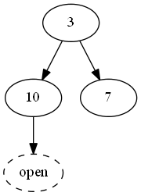


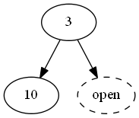

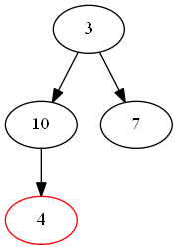
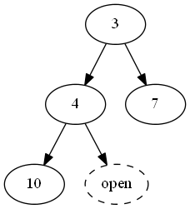
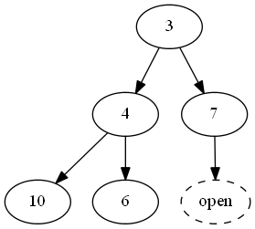
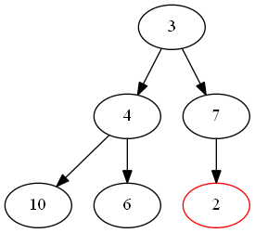
Heap questions
CS 261 – Data Structures

Slide 26
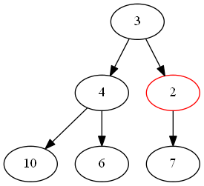
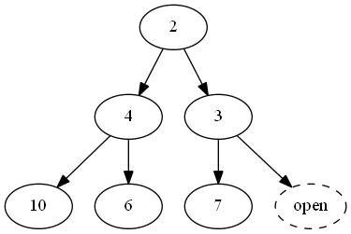
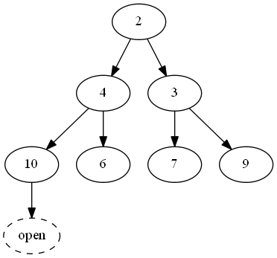
Heap questions
CS 261 – Data Structures

Slide 27
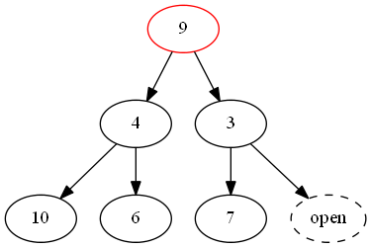
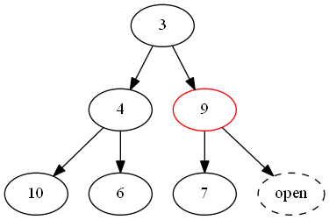
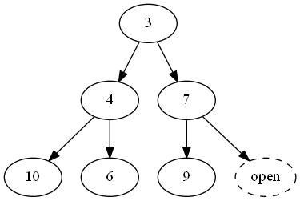
Heap questions
Now, show the effect of removing 2 from the heap.
CS 261 – Data Structures

Slide 28
Hash Table
Table
0
...
1
next
...
2
Key
Value
3
4
D-1
...
struct hashMap {
hashLink ** table;
int tableSize;
int count;
};
struct hashLink {
KeyType key;
ValueType value;
struct hashLink * next;
};
CS 261 – Data Structures
Notes:
struct hashLink {
KeyType key; /*the key is what you use to look up a hashLink*/
ValueType value; /*the value stored with the hashLink, a pointer to int in the case of concordance*/
struct hashLink * next; /*notice how these are like linked list nodes*/
};
typedef struct hashLink hashLink;
struct hashMap {
hashLink ** table; /*array of pointers to hashLinks*/
int tableSize; /*number of buckets in the table*/
int count; /*number of hashLinks in the table*/
};

Slide 29
Hash Table: insert to hash map
Insert
1- Key does not exist in the table, a new hashLink should be add to the hashMap
...
...
...
Void insertMap (struct hashMap * ht, KeyType k, ValueType v)
  //find the index of the key in the table
  newLink = malloc(sizeof(struct hashLink));
  ht->table[index]=newLink;
  ht->table[index]->key=k;
  ht->table[index]->value=v;
  ht->table[indext]->next=Null;
  ht->count++; ……
CS 261 – Data Structures
Notes:
struct hashLink {
KeyType key; /*the key is what you use to look up a hashLink*/
ValueType value; /*the value stored with the hashLink, a pointer to int in the case of concordance*/
struct hashLink * next; /*notice how these are like linked list nodes*/
};
typedef struct hashLink hashLink;
struct hashMap {
hashLink ** table; /*array of pointers to hashLinks*/
int tableSize; /*number of buckets in the table*/
int count; /*number of hashLinks in the table*/
};

Slide 30
Hash Table: insert to hash map
Insert
2- The Key exists in the table, then the value of the hashLink should be changed
int *count =(int *)atMap(“and”);
insertMap(“and”, *counter+1);
...
...
...
Key
Value
CS 261 – Data Structures
Notes:
struct hashLink {
KeyType key; /*the key is what you use to look up a hashLink*/
ValueType value; /*the value stored with the hashLink, a pointer to int in the case of concordance*/
struct hashLink * next; /*notice how these are like linked list nodes*/
};
typedef struct hashLink hashLink;
struct hashMap {
hashLink ** table; /*array of pointers to hashLinks*/
int tableSize; /*number of buckets in the table*/
int count; /*number of hashLinks in the table*/
};

